Slide 1
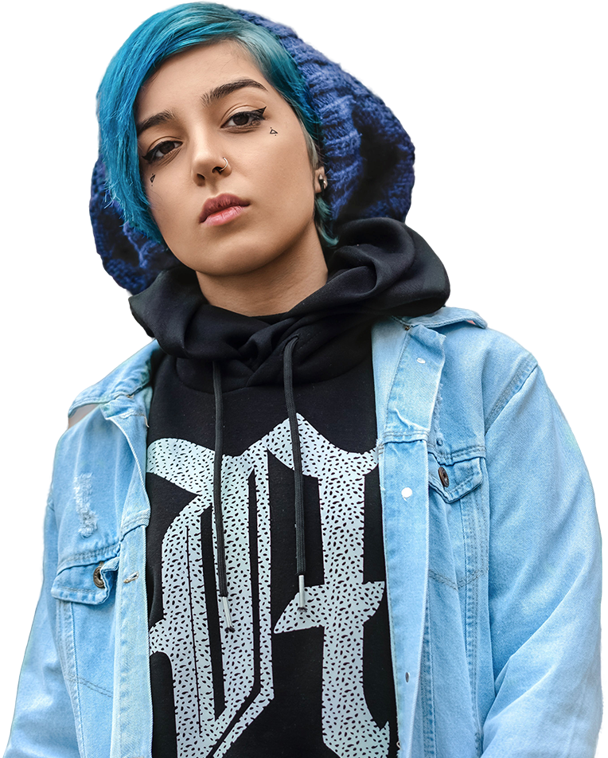
O2|LashPass
Fintech
DevPack

Slide 2
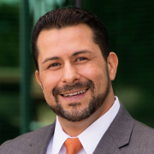

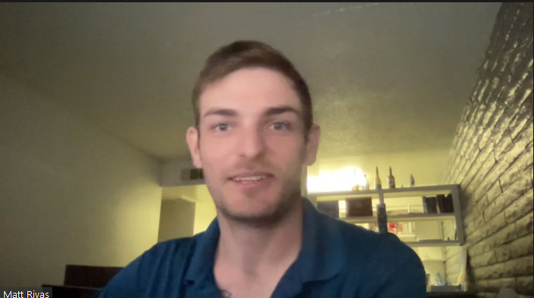
Project 3 Team: JJ, Matt, and Shanel
JJ Torres
Contributor
Matt Rivas
Contributor
Shanel Kuchera Contributor
June 2022

Slide 3

Big concept
Applying Fintech to modern day strategies to propel business and consumers to grow business reach and revenue using Blockchain technology.

Slide 4

How can I use Cryptocurrency and Fintech to expand my business reach and productivity?

Slide 5

Our process is easy
Partner with FinTechTiger
Customize your Token
Deploy your Contracts
We offer a Fintech DevPack to help you reach new customers and increase productivity by integrating cryptocurrency exchange for membership services and offering NFT tokens. .
We build a unique, personalized platform on blockchain technology using smart contracts to exchange cryptocurrency and offer digital services with NTFs and tokens.
We deploy your DevPack and provide an advanced front end user interface to manage your service offerings and further develop your digital business and presence.

Slide 6

DevPack Design and Development
Project Requirements:
Define business requirement and scope
Manage contracts to track ownership
Allocation of resources: Remix, OpenZeppelin, VScode, Pycharm, Ropsten, Streamlit
Token selection: ERC 1155, token inheritance

Slide 7

Building, Programming, Testing
ERC 1155 customization of hybrid token
Inherited second contract for efficiency while adding functionality
OpenZeppelin libraries (9) to standardize our security and verifications
Preserve trust within crypto community

Slide 8
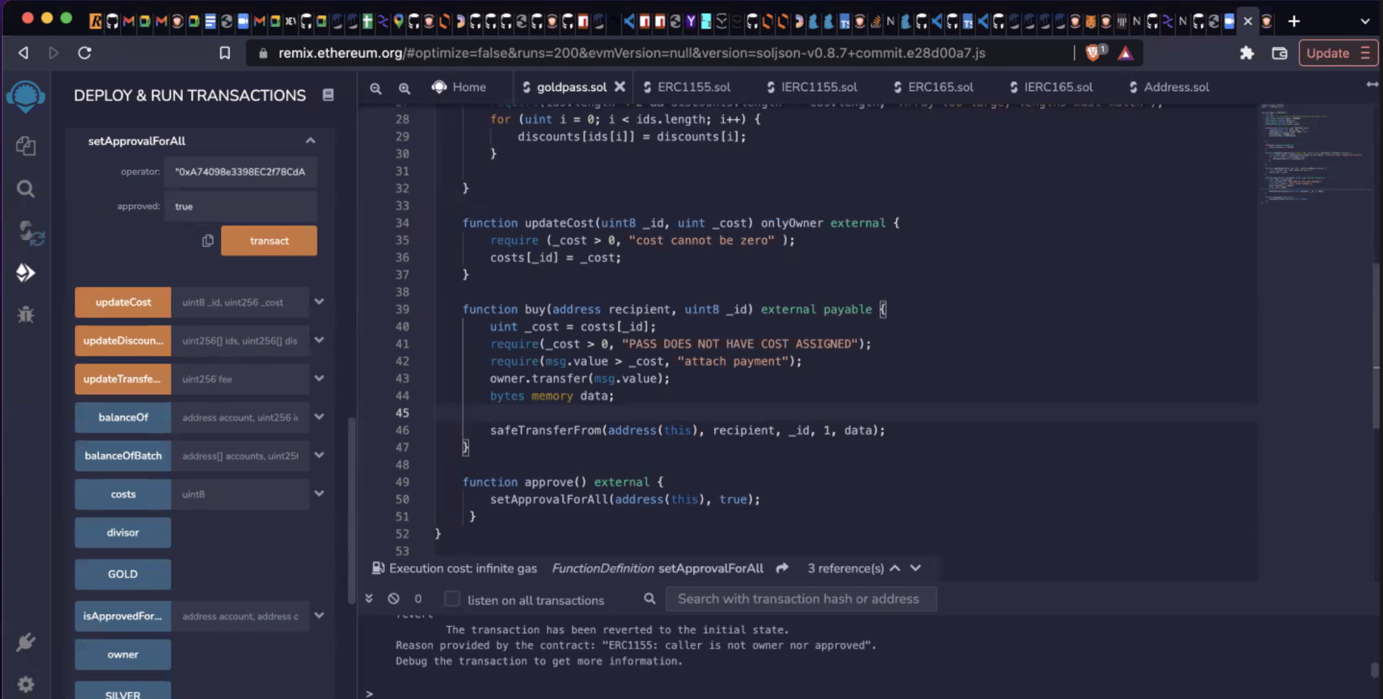
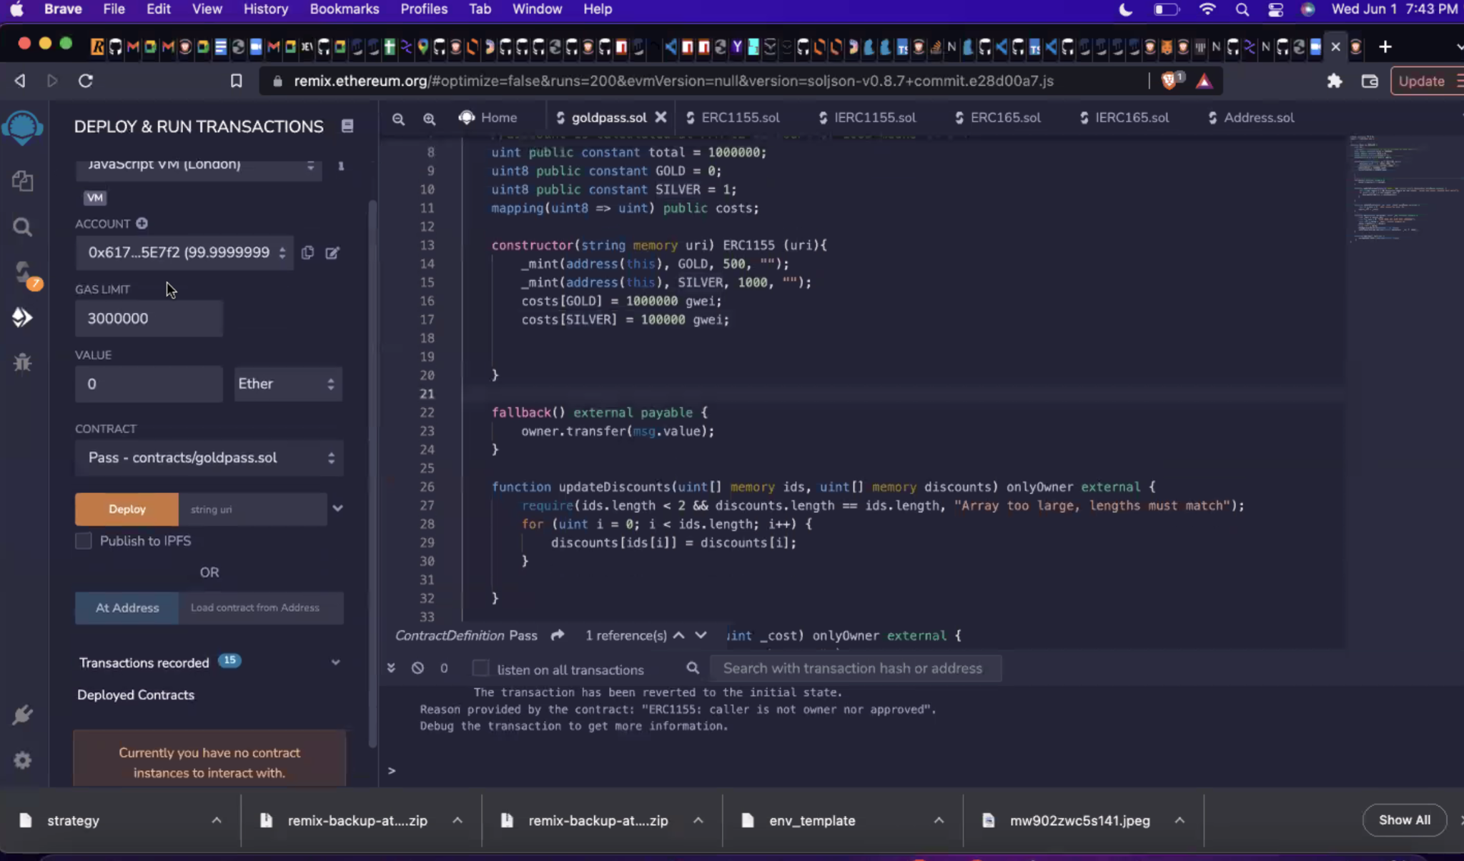
Deployment
VScode
Python
Solidity
StreamLit Frontend
Web3py/Infura
EVM compatible
Pay using Ether
Future-Javascript for MetaMask and WalletConnect

Slide 9
SWOT Analysis for Testing
STRENGTHS
Architecture of contracts adding flexibility and stability
WEAKNESSES
U/X interaction needed improvement and exchange of publicly available buy method
S
W
Expand on front end to build on CSS or HTML platform with server- MM, WC
OPPORTUNITIES
Limited customization and features or limiting cryptocurrency exchange with new tokens
THREATS
O
T

Slide 10
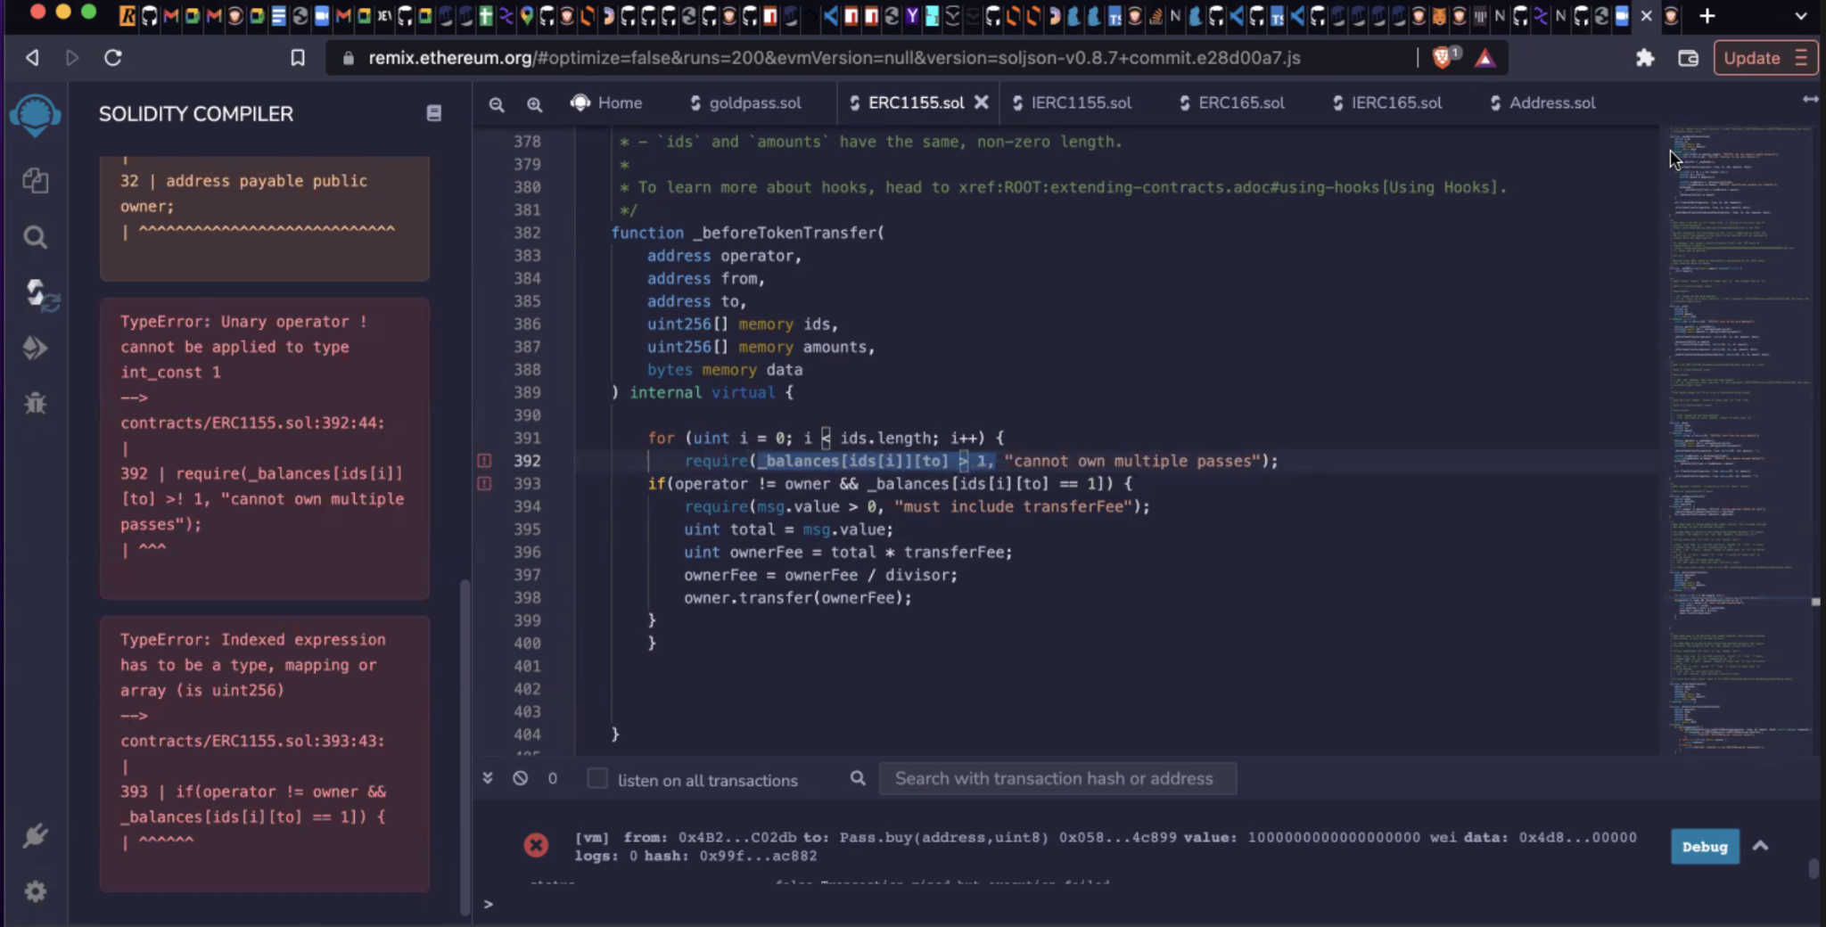
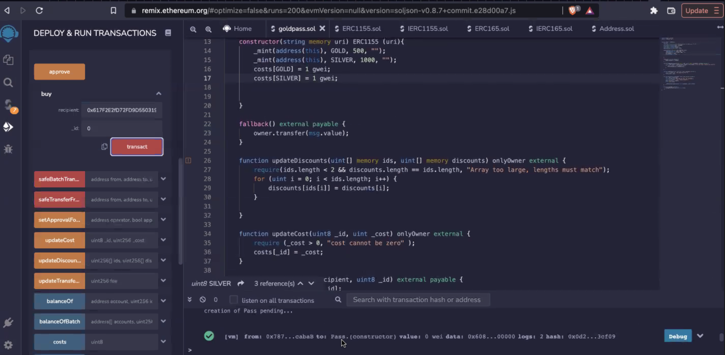
2. Testing and Improvements
Confirm to safe standards to build trust with cryptocurrency

Slide 11
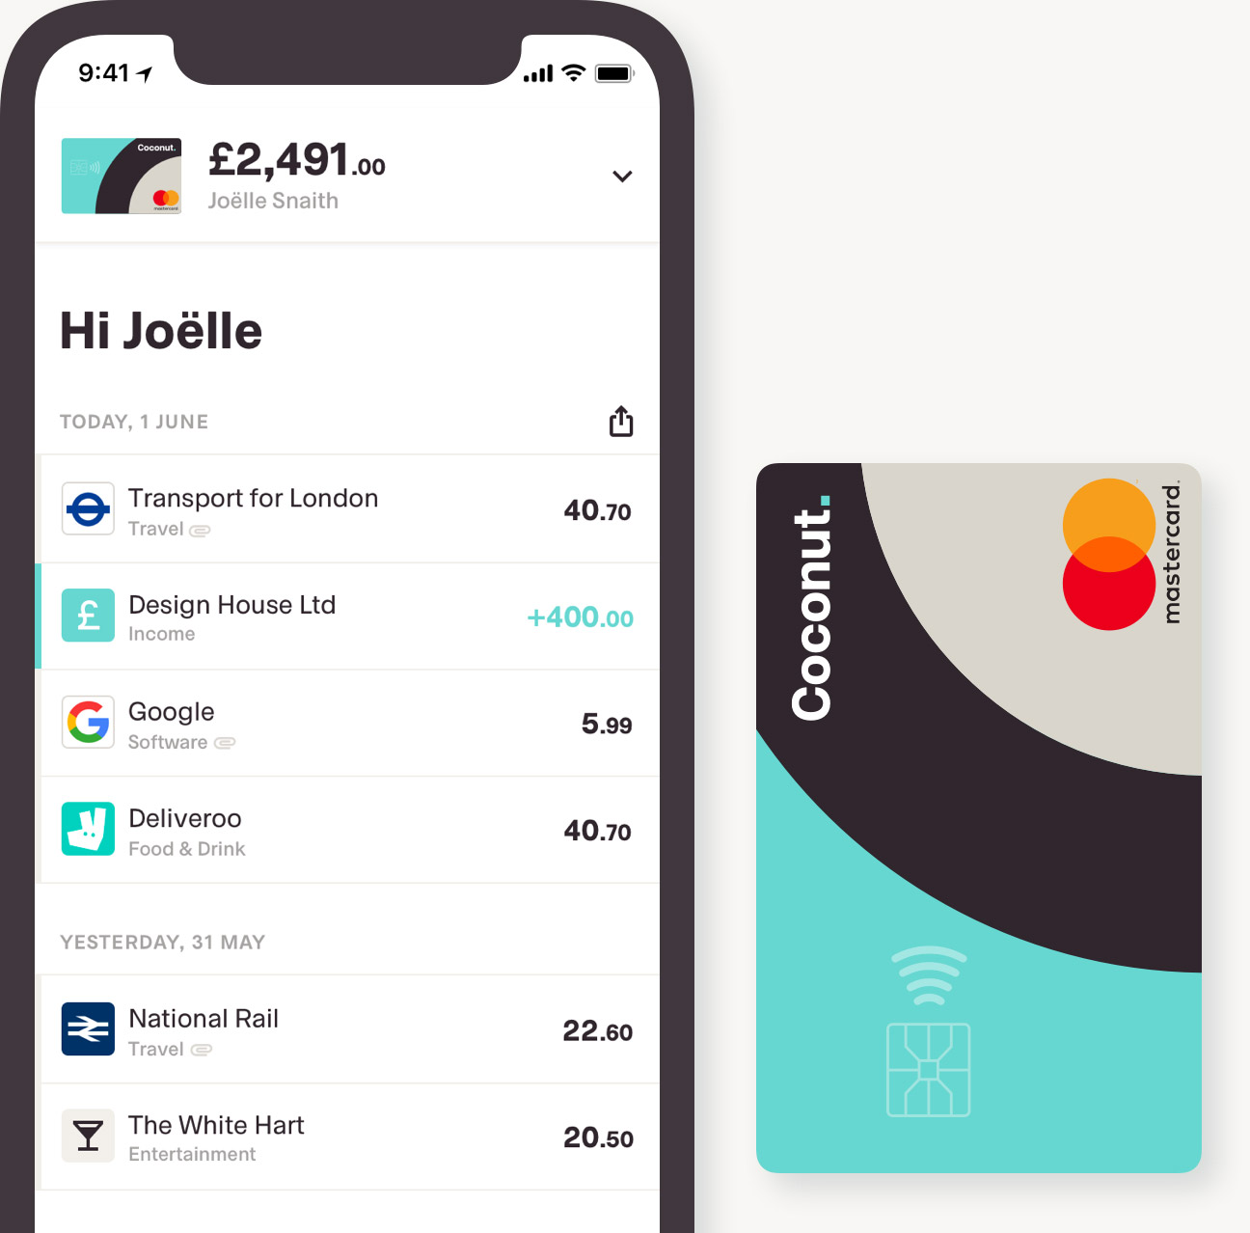
Live Deployment
Deployed on Ropsten testnet - Ether Wallet
Streamlit IDE Frontend
Expand Contract Features and Offerings

Slide 12

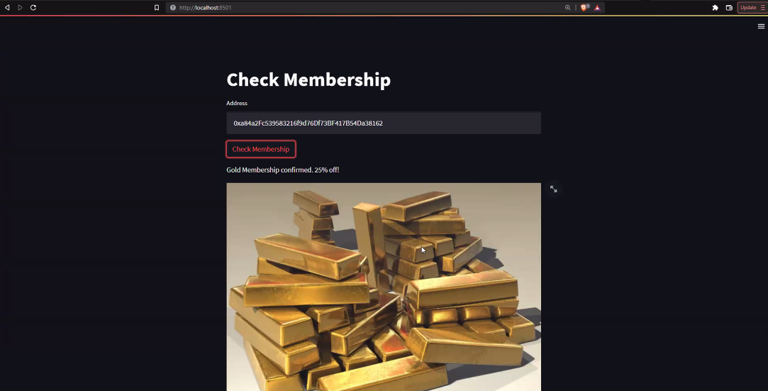
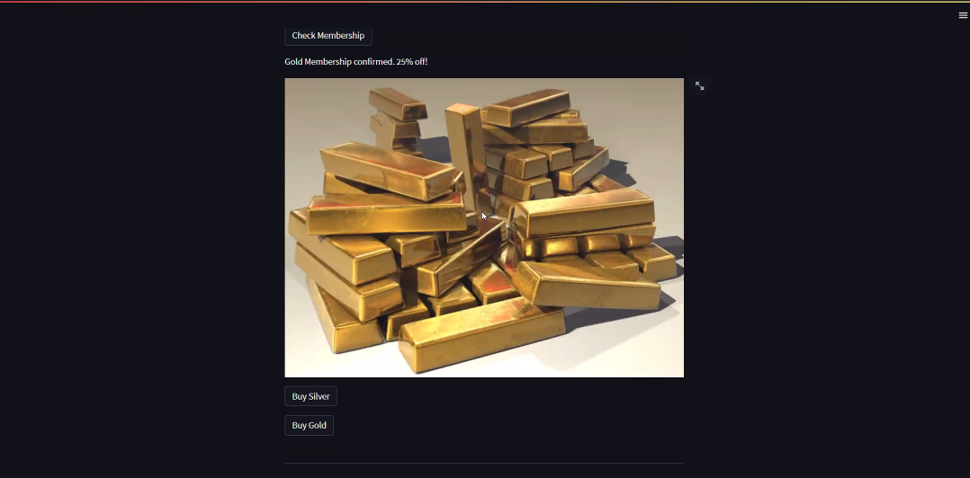
Want big impact?
Use big image.

Slide 13

Client Delivery Package: DevPack
DevPack Soft Launch: Digital Announcement of DevPack on Social media
Hard Launch: Deployment of smart contracts front end IDE
Membership Services: Gold and Silver Tier NFT offerings

Slide 14

O2 | LashPASS
A new NFT membership offering company discounts, exclusive events, and 1 of 1 LashPASS Swag Bags delivered to your doorstep.

Slide 15
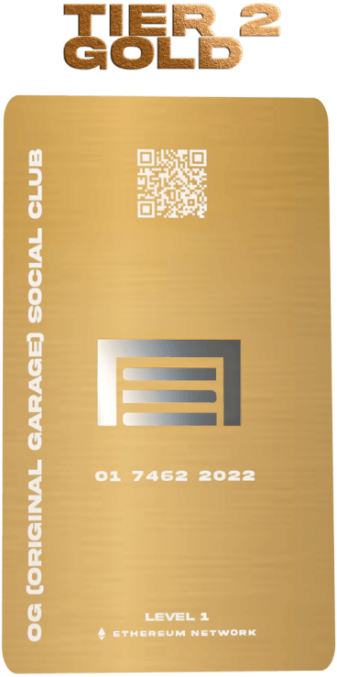
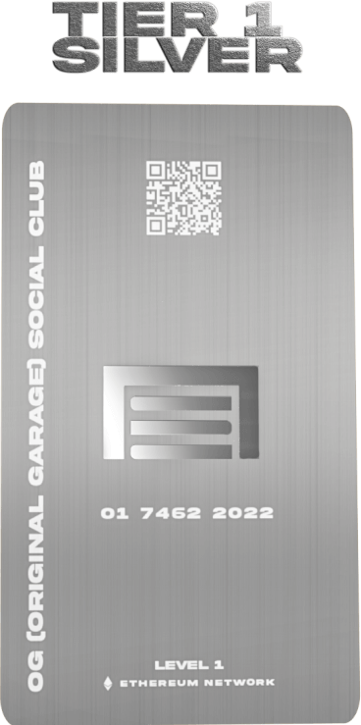
Membership Privileges
 | Discounts | Exclusive Events Invitation | Monthly Swag Bag
Yellow | 35% | 24 | 12/yr
Blue
Orange | 15% | 12 | 6/yr

Slide 16
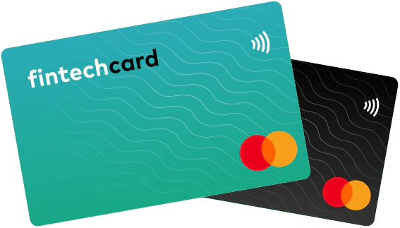
4000
3000
2000
1000
0
Forecasted Business Sales: using facebook prophet sentiment analysis adding Fintech tools to Business Enterprise. Year over Year starting in 2020

Slide 17
Potential Reach of New Clients using Cryptocurrency
FinTechTiger
Forecasted through 2029

Slide 18

$89,526,124 in potential revenue! (March 2022)
Upcoming Improvements:
Payment Capabilities - Exchange “Lash Pass Tokens” for services
Earn Tokens for Reviews and Social Media Interactions
Elite Membership membership allowing for Profit Sharing through residual Membership recruiting

Slide 19

$89,526,124
185,244 new members
100%
That’s a lot of money
And a lot of users
Total success!

Slide 20

Thanks!
Any questions?
👉Please like us on Facebook and follow us on TikTok and Instagram👍

